Slide 1
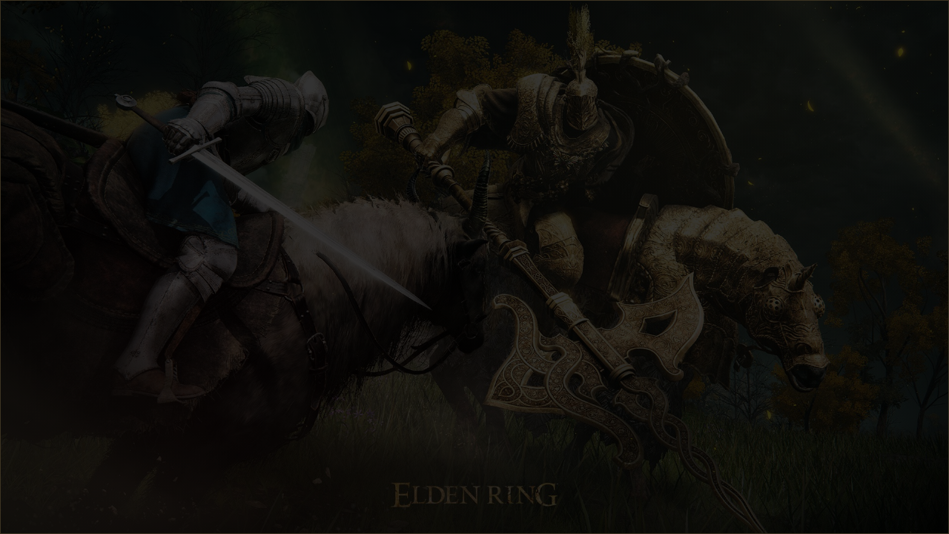
PYTHON: POWER OF THE SCRIPT
Coding the Lands Between
"Arise, Tarnished, and forge thy journey through code."

Slide 2

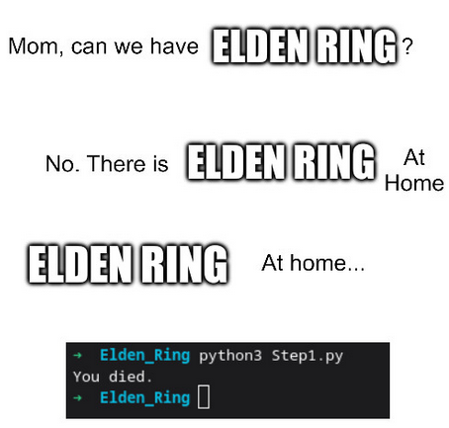
Iowa Western Community College
Discovery Days: Python – Creating “Elden Ring”

Slide 3
Iowa Western Community College
About Your Instructor
Mr. Justin Miller
Master’s Degree in Cybersecurity
Professor of Cybersecurity and Web Design
CIT Department, Iowa Western Community College
jemiller@iwcc.edu

Slide 4

PART I: THE FIRST GRACE
Fundamentals of Output, Color, and Logic

Slide 5


MANIFESTING REALITY
STEP 1: OUTPUT
The print() function is our first incantation. It is the first that you will learn.
This will output the words Hello, World! in the terminal:

Slide 6

MANIFESTING REALITY: Your Turn
STEP 1: OUTPUT
Open the file Step1_pseudocode.py
Click File > Save As
Save the file as Step1.py
On line 7, use the print() function to output the words You Died. to the screen.
Don’t forget the syntax: print(“Your Text”)
Save the file
STEP 1: Running
Open the terminal if it is not yet:
Click the icons that look similar to this:
Click the Terminal Tab in the window that opens
Run the program: python Step1.py

Slide 7


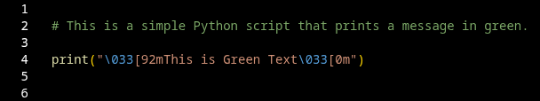

MANIFESTING REALITY
STEP 1a: OUTPUT, but with color!
STEP 1a: OUTPUT, but with color!
The print() function is our first incantation. We use ANSI escape sequences for color.
Important: Escape codes like \033[91m tell the terminal to change state. We must Reset the color or the screen will remain forever!
# Color Examples:
RED = "\033[91m"
GREEN = "\033[92m"
YELLOW = "\033[93m"
CYAN = "\033[96m"
RESET = "\033[0m"
How does it look?

Slide 8
Color: Your Turn
STEP 1: OUTPUT
Click File > Save As
Save the open file as Step1a.py
On line 7, edit the print() function to output the words You Died. to the screen in a befitting red color.
Don’t forget the syntax: print(“’open escape sequence’Your Text’reset escape sequence’”)
RED = \033[91m
RESET = \033[0m
Save the file
STEP 1: Running
Open the terminal if it is not yet:
Click the icons that look similar to this:
Click the Terminal Tab in the window that opens
Run the program: python Step1a.py

Slide 9
User Input and Choices
If/Elif/Else logic mirrors the branching choices in the game. We path the player based on their input.
Logic Hierarchy:
Logic Hierarchy:
If: The primary condition.
Elif: Chained alternative conditions.
Else: The catch-all (the "everything else" path).
Variables:
A way to store a value by the program to be used later.
Input:
A way to interact with the user

Slide 10
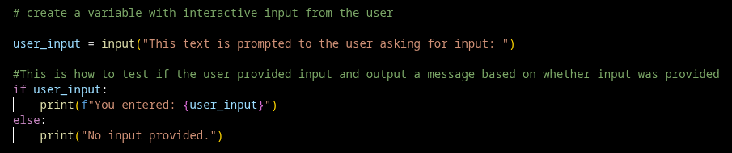
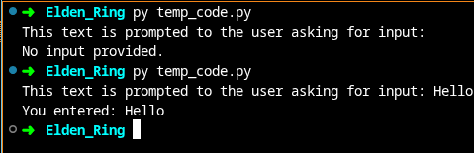
User Input and Choices: How it Looks in Python

Slide 11
User Input and Choices: Your Turn
Code
Open the file Step2_pseudocode.py
Click File > Save As
Save the file as Step2.py
Use the commented pesudocode to guide you with using input and if/else statements
Save the file
Running your Code
Open the terminal if it is not yet:
Click the icons that look similar to this:
Click the Terminal Tab in the window that opens
Run the program: python Step2.py

Slide 12
T
User Input and Choices: Making it case-insensitive
This allows for all input to be read the same:
Bob
bob
BOB
bOb
These all will be read by Python as:
bob

Slide 13




THE FIRST BEAST
Step 3: Randomness. We import the random module to simulate the dice rolls of battle.
import
str
randint
0
1
We have the user pick a number. Random simulates the enemy picking a number. Matching numbers means the beast is vanquished. Failure means the player's end.
"Thy kind are denied the Elden Ring... unless the code holds true."

Slide 14
Beast Battle: Your Turn
Code
Open the file Step3_pseudocode.py
Click File > Save As
Save the file as Step3.py
Use the commented pesudocode to guide you with developing your code
Save the file
Running your Code
Open the terminal if it is not yet:
Click the icons that look similar to this:
Click the Terminal Tab in the window that opens
Run the program: python Step3.py

Slide 15

THE BOSS BATTLE: Margit
Success Rate
STEP 4: SCALING DIFFICULTY
10%
We increase the random range to 0-9. The player's survival now requires a precise 1 in 10 guess.
str
randint
0
9
Note: We reuse variables like enemy and beast because we no longer need the previous battle's data. This is memory efficiency.
Probability vs. Margit

Slide 16
Boss Battle: Your Turn
Code
Open the file Step3.py
Click File > Save As
Save the file as Step4.py
Copy all code (except import random) and paste at the bottom
Edit the pasted code to reflect a boss battle against Margit with a 1 in 10 chance of winning.
Save the file
Running your Code
Open the terminal if it is not yet:
Click the icons that look similar to this:
Click the Terminal Tab in the window that opens
Run the program: python Step4.py

Slide 17
Boss Battle: A Fatal Flaw in Our Code
Bugs
Some bugs are obvious: They won’t let you run your code at all
Others, not so obvious. They run but things don’t work as you might expect.
Can you see the issue with ours?

Slide 18
Boss Battle: A Fatal Flaw in Our Code
Bugs
If we lose to the first beast, we shouldn’t be able to move onto fight Margit.
Currently, our code still lets us.
There is a simple, elegant solution to this:
exit()
Adding this line after our “You Died” print statement of the first battle ensures that the game exits if we lose

Slide 19




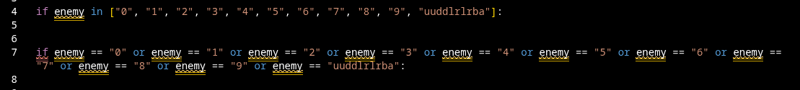
THE HIDDEN RUNES: Adding A Cheat Code WITH “OR”
THE OR OPERATOR
THE IN KEYWORD
Used to check for cheat codes like the Konami code.
Best for one to three choices.
Used for clean lists. Far superior to multiple OR statements when there are many choices.
These both complete the same task, but one is far more efficient:

Slide 20
Cheat Codes: Your Turn
Code
Open the file Step4.py
Click File > Save As
Save the file as Step5.py
Add or enemy == “uuddlrlrba” at the end of the if statements for the battles before the colon
Save the file
Running your Code
Open the terminal if it is not yet:
Click the icons that look similar to this:
Click the Terminal Tab in the window that opens
Run the program: python Step5.py
Instead of a number, try typing uuddlrlrba as your input

Slide 21

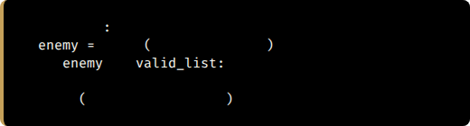
THE TRAP LOOP: While
Step 6: Input Validation. We use a while True loop to trap the player until they provide a valid number.
while True
input
"Choose 0-9: "
if
in
break
print
"Invalid choice!"
The break statement is the key to escaping the cycle once rules are followed.

Slide 22
While Loops: Your Turn
Code
Open the file Step5.py
Click File > Save As
Save the file as Step6.py
Change your enemy = variable declarations into code that verifies if your input is valid.
Tip: For the first enemy, use or statements, but use the in keyword and list for Margit
Save the file
Running your Code
Open the terminal if it is not yet:
Click the icons that look similar to this:
Click the Terminal Tab in the window that opens
Run the program: python Step6.py
Instead of a number, try typing uuddlrlrba as your input

Slide 23
Coding Challenge
Code
Go to the site: https://github.com/jemiller-iwcc/python-challenge
Use either the README.md file in your browser or download the PDF. Both contain the same data.
Follow the instructions that are within to make a multi-enemy boss battle.
You do not need to know anything more than what we learned yesterday

Slide 24
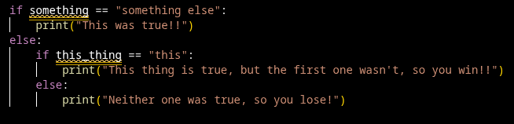
THE HIDDEN RUNES: Nested If Statements
Nesting If Statements
If two unrelated things can make a statement true, then we can nest the if statements

Slide 25
Nested If Statements: Your Turn
Code
Open the file Step6.py
Click File > Save As
Save the file as Step7.py
After import random, add a line with the variable player_name using input asking the player’s name, the variable to lower case
Under the first beast battle, under the else statement, nest an if/else statement where it checks if the value of player_name is “justin”
If the name is justin, let them win
If the name isn’t justin, then use the existing else “you died” sequence”
Copy and paste this code into the boss battle
Running your Code
Open the terminal if it is not yet:
Run the program: python Step7.py

Slide 26
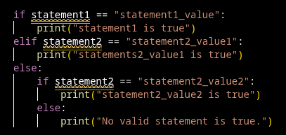
THE HIDDEN RUNES: elif Statements
Elif Statements
The other option for an if statement is called elif

Slide 27
Elif Statements: Your Turn
Code
Open the file Step7.py
Click File > Save As
Save the file as Step8.py
After the if statement, but before the else, add an elif code block that checks if the variable player_name matches your name in lower case.
If the name matches, let yourself win!
Running your Code
Open the terminal if it is not yet:
Run the program: python Step8.py

Slide 28
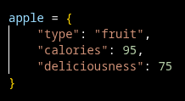
Dictionary Entries
Step 9: Dictionary entries allow for multiple values in a variable
We will use this to create the Samurai Class in our Code

Slide 29
Dictionary Entries: Your Turn
Code
Open the file Step8.py
Click File > Save As
Save the file as Step9.py
Open Step9_pseudocode.py and use the instructions in there to help you create an entry for the Samurai
Running your Code
Open the terminal if it is not yet:
Run the program: python Step9.py

Slide 30
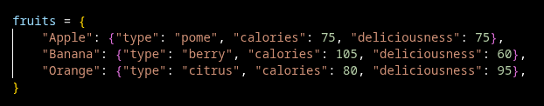
Dictionary Entries with Multiple Entries
Step 10: Dictionary entries allow for multiple values in a variable:
Using this, we can select from multiple classes in our code.

Slide 31
THE ARCHIVES OF STATS
Step 10: Dictionaries. We store character classes in an associative array (key-value pairs).
Key | Type | HP | Attack
"1" | Samurai | 10 | 20
"2" | Prisoner | 20 | 4
"3" | Prophet | 30 | 4

Slide 32
Dictionary Entries: Your Turn
Code
Open the file Step9.py
Click File > Save As
Save the file as Step10.py
Open Step10_pseudocode.py and use the instructions in there to help you create an entry for the Samurai
Running your Code
Open the terminal if it is not yet:
Run the program: python Step10.py

Slide 33
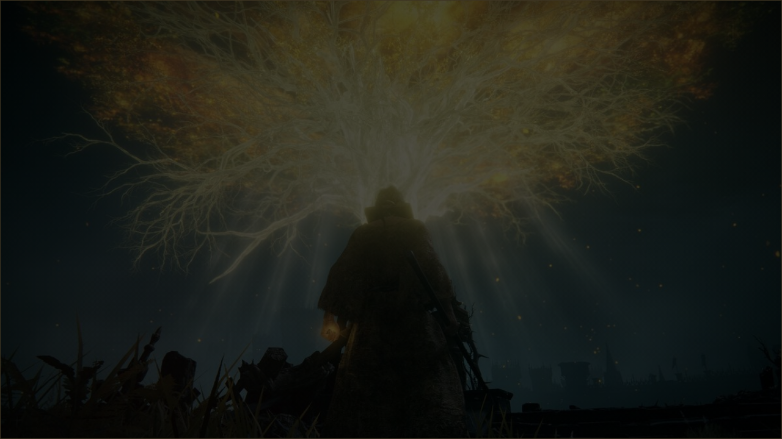

ELDEN LORD
The Journey Complete
You have mastered input, variables, logic, loops, and data structures. The Lands Between are yours to command.

Slide 34

Where do we Go From here?
We don’t have time to get into more detail in this course and actually use these dictionary entries.
But you can build it on your own if you want!
As a bonus, I have a completed a version of the code that you can play and use. It has all the features we learned plus one we didn’t cover: functions.
You can get it here:
https://github.com/jemiller-iwcc/python-elden-ring
All code solutions, pseudocode, and these slides are on the site.

Slide 35

QUESTIONS?
Thy quest continues in the terminal.
Justin E. Miller, jemiller@iwcc.edu

Slide 36





SOURCES
https://eldenring.wiki.fextralife.com/file/Elden-Ring/samurai_class_elden_ring_wiki_guide_270px.png
Source: eldenring.wiki.fextralife.com
https://i.redd.it/rktzg4cigl991.jpg
Source: www.reddit.com
https://png.pngtree.com/thumb_back/fh260/background/20200724/pngtree-background-brown-dark-parchment-texture-image_364033.jpg
Source: pngtree.com
https://images4.alphacoders.com/121/thumb-1920-1214929.jpg
Source: wall.alphacoders.com
https://cdn.mos.cms.futurecdn.net/GUwnMR2gDjdhWbTdzr9f5C-1200-80.jpg
Source: www.windowscentral.com
Inspired by Network Chuck: https://www.youtube.com/watch?v=Fq6gqi9Ubog

